Slide 1

NSG Pilkington – University of Liverpool Machine Learning Project: 24/03/2021
Dr. Peter Green
Diego Echeverria
Sarini Jayasinghe
Risk Institute,
School of Engineering

Slide 2
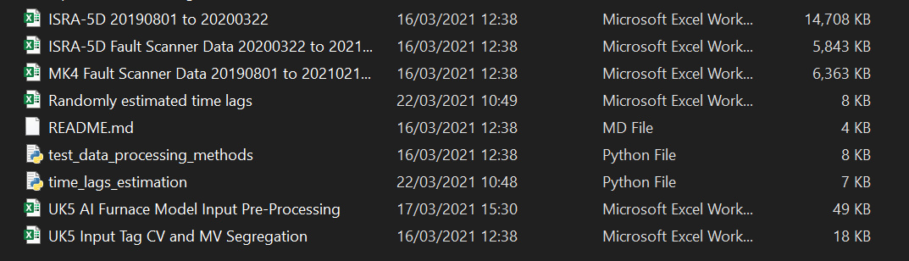
Ordering code and files
We currently have different files corresponding to different time periods.

Slide 3
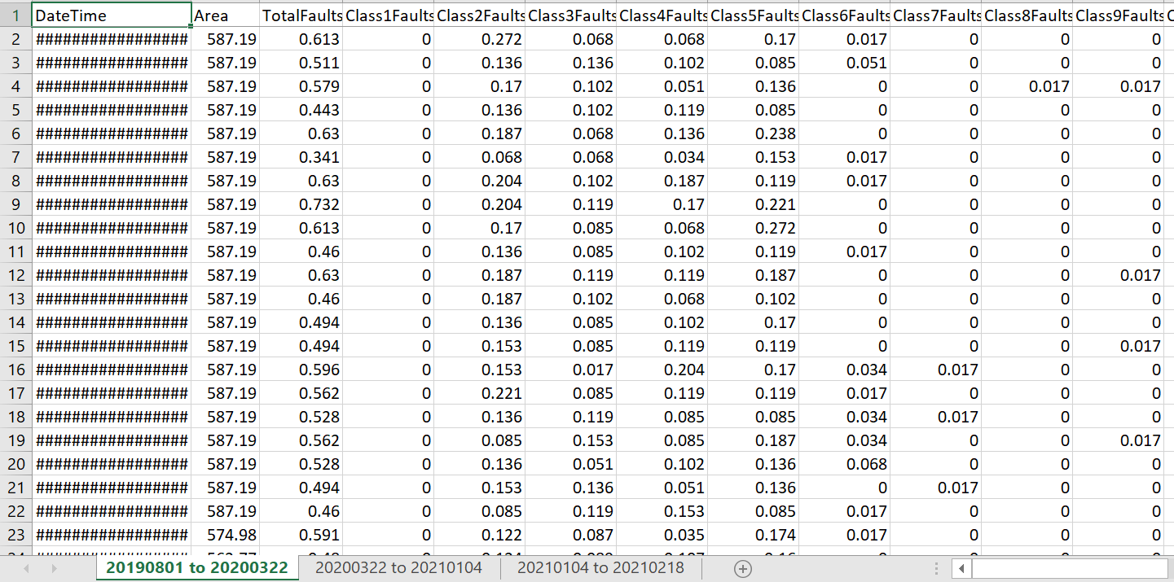
Ordering code and files
We currently have different files corresponding to different time periods.
Within some files we have split data.

Slide 4
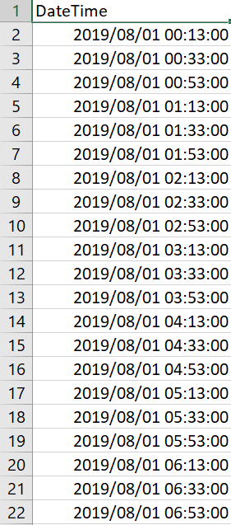
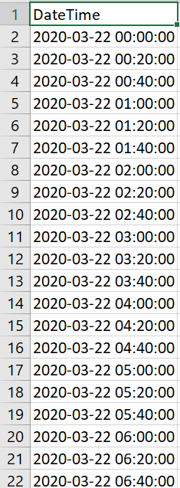
Ordering code and files
Some sheets corresponding to different periods of time are in different formats.

Slide 5
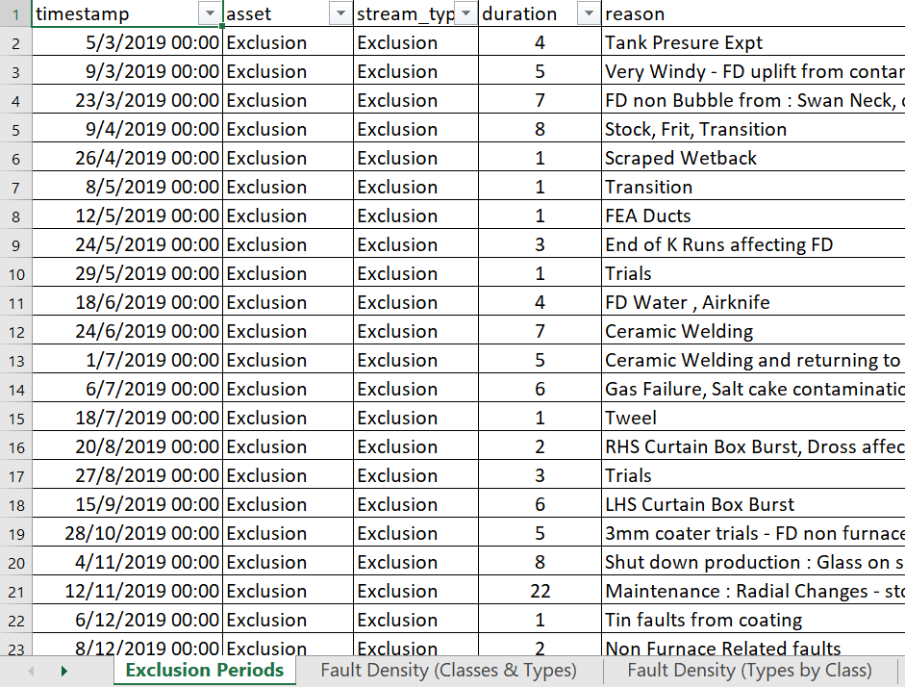
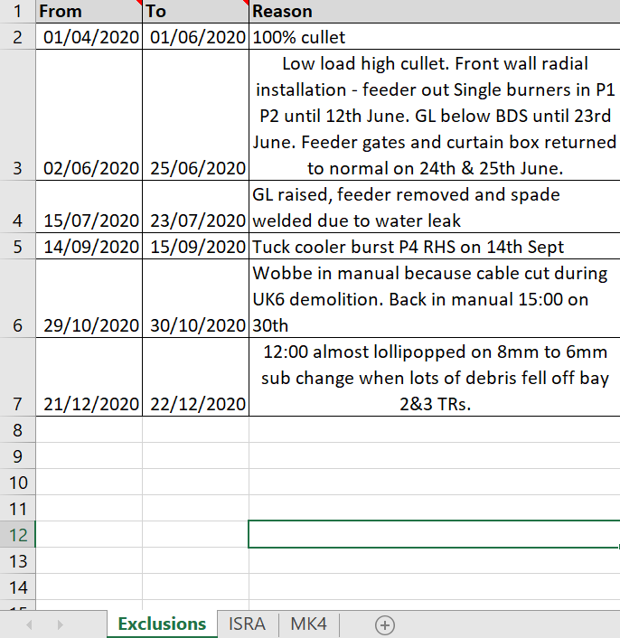
Ordering code and files
Some sheets corresponding to different periods of time are in different formats.

Slide 6
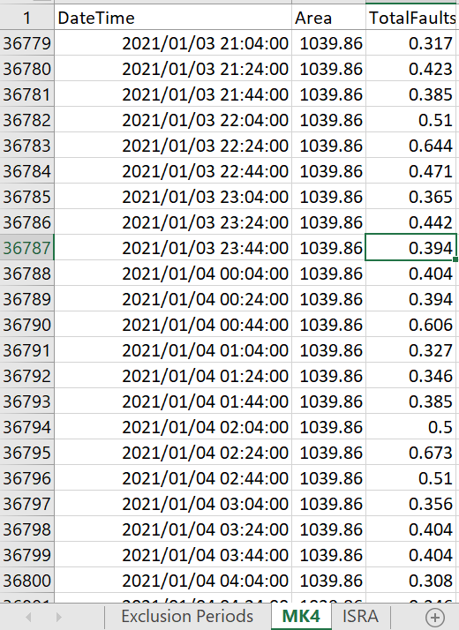
Ordering code and files
In order to develop code that can read between different scanners (MK4 or ISRA-5D) and time periods. We would like to have a single ‘Fault Scanner Data 20190801 to 20210218’ file that looks like this,

Slide 7
Ordering code and files
In order to develop code that can read between different scanners (MK4 or ISRA-5D) and time periods. We would like to have a single ‘Fault Scanner Data 20190801 to 20210218’ file that looks like this,
We already did this manually and there were no problems with the MK4 data. However, the ISRA -5D were in different formats for the different time periods.
If the ISRA-5D data is going to be used in the future, we can use this general format
An example file will be provided after this meeting

Slide 8

Estimating time lags randomly
This is how we generate N samples of the time lags.
$$time lags=time la{gs}_{Pilkington}+s r$$
$$r∼N\left({0,1}^{2}\right)$$
Were $s$ is a variable defined by the user that controls the maximum time lags that can be sampled from, for instance,
Tag: 8122 Regenerator Base Temperature Port 1 LHS
Time lag provided = 36 hours
Should we assume that it is possible that this tag can have a time lag = 72 hours?
If that is the case, then $s=108$ (units of time) or $s=36$ (hours).
Should we restrict the sampled time lags to be always >= than the time lags provided?
This information will give us an idea of how many simulations we have to run to estimate the ‘best’ time lags.

Slide 9
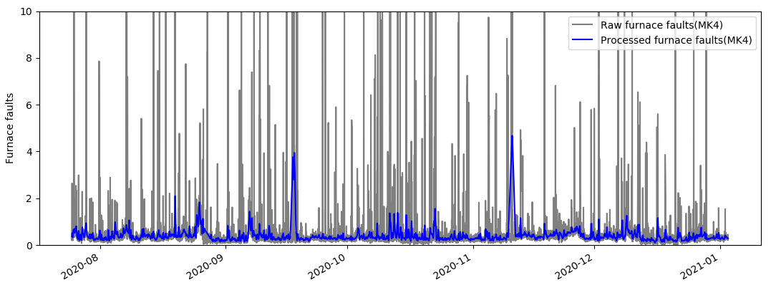
Dataset 2 (2020 to 2021, around N=11500)
MK4 data filtering (spike removal - 3 sigma from mean)
Mean and standard deviation calculated considering furnace faults <10
Low pass filter, cutoff-frequency W_{LC}= 0.1≈3hrs

Slide 10
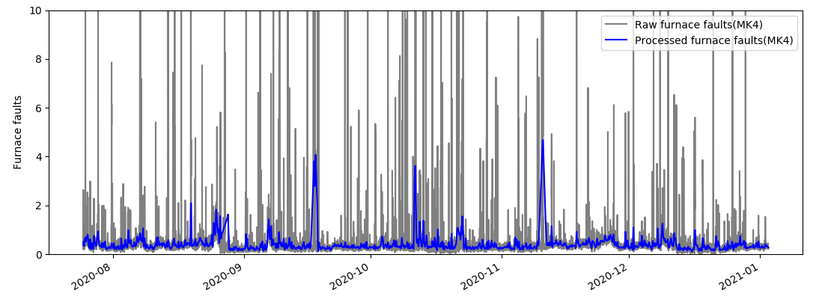
Dataset 2 (2020 to 2021, around N=11500)
MK4 data filtering (spike removal - 3 sigma from mean)
Mean and standard deviation calculated considering furnace faults < 8
Low pass filter, cutoff-frequency W_{LC}= 0.1≈3hrs

Slide 11
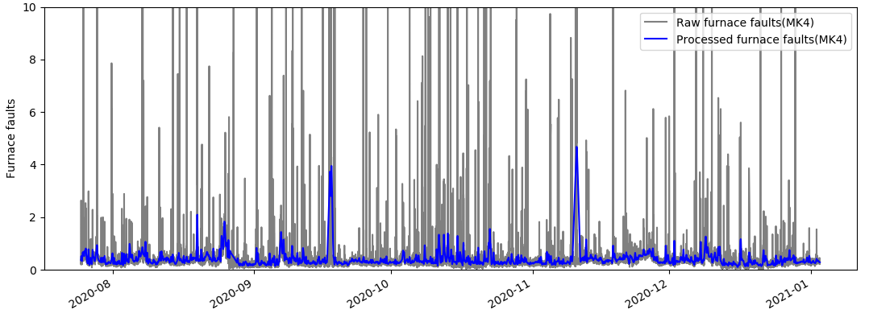
Dataset 2 (2020 to 2021, around N=11500)
MK4 data filtering (spike removal - 3 sigma from mean)
Mean and standard deviation calculated considering furnace faults <12
Low pass filter, cutoff-frequency W_{LC}= 0.1≈3hrs

Slide 12
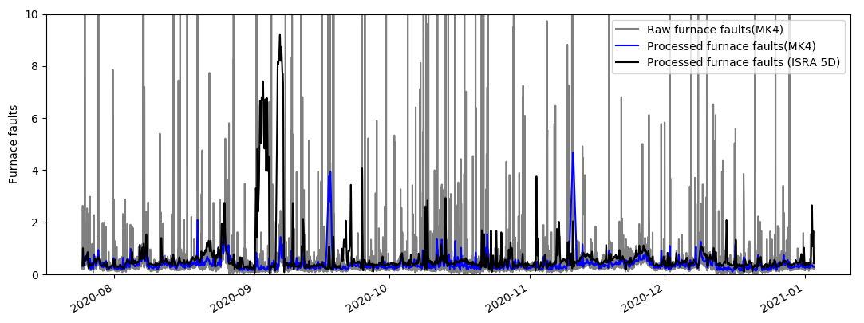
Dataset 2 (2020 to 2021, around N=11500)
MK4 data filtering (spike removal - 3 sigma from mean)
Mean and standard deviation calculated considering furnace faults < 10
Low pass filter, cutoff-frequency W_{LC}= 0.1≈3hrs

Slide 13
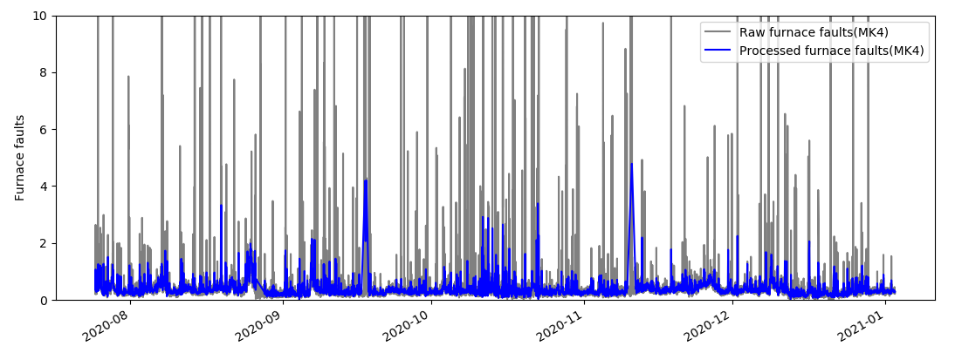
Dataset 2 (2020 to 2021, around N=11500)
MK4 data filtering (spike removal - 3 sigma from mean)
Mean and standard deviation calculated considering furnace faults < 10
Low pass filter, cutoff-frequency W_{LC}= 0.16≈2hrs

Slide 14
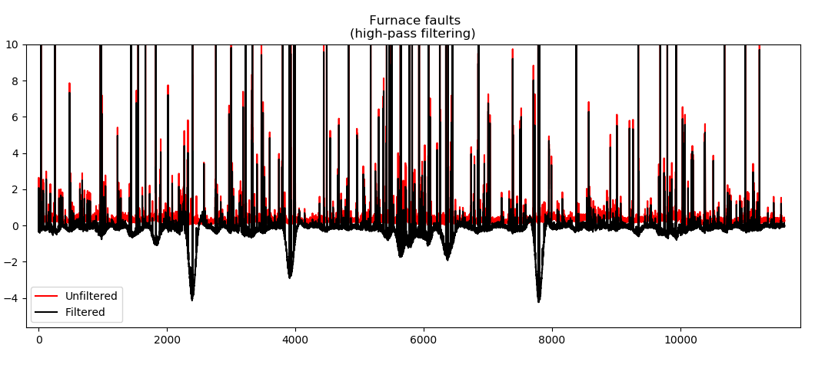
Dataset 2 (2020 to 2021, around N=11500)
High pass filtering

Slide 15
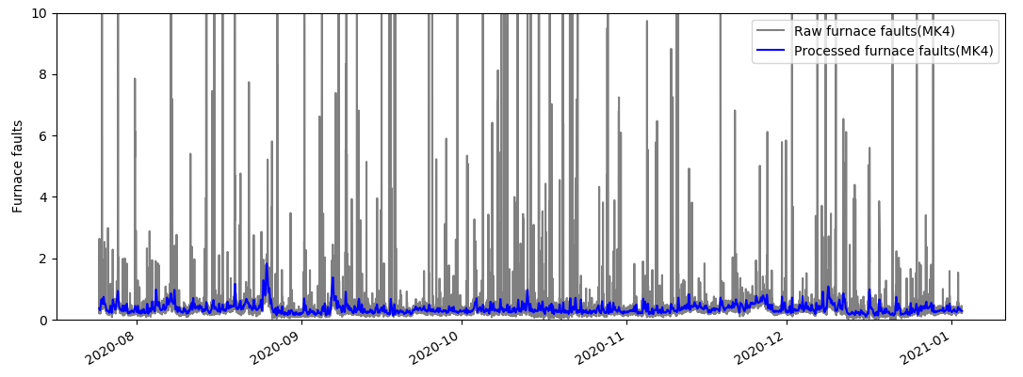
Dataset 2 (2020 to 2021, around N=11500)
MK4 data filtering without the high pass filter (spike removal - 3 sigma from mean)
Mean and standard deviation calculated considering furnace faults < 10
Low pass filter, cutoff-frequency W_{LC}= 0.1≈3hrs

Slide 16
Min-Max error
We found that inputs outside of the ‘engineering limits’ were actually being allowed through the data processing pipeline.
Do we really want to ‘throw away’ signals that are outside of this range?

Slide 17
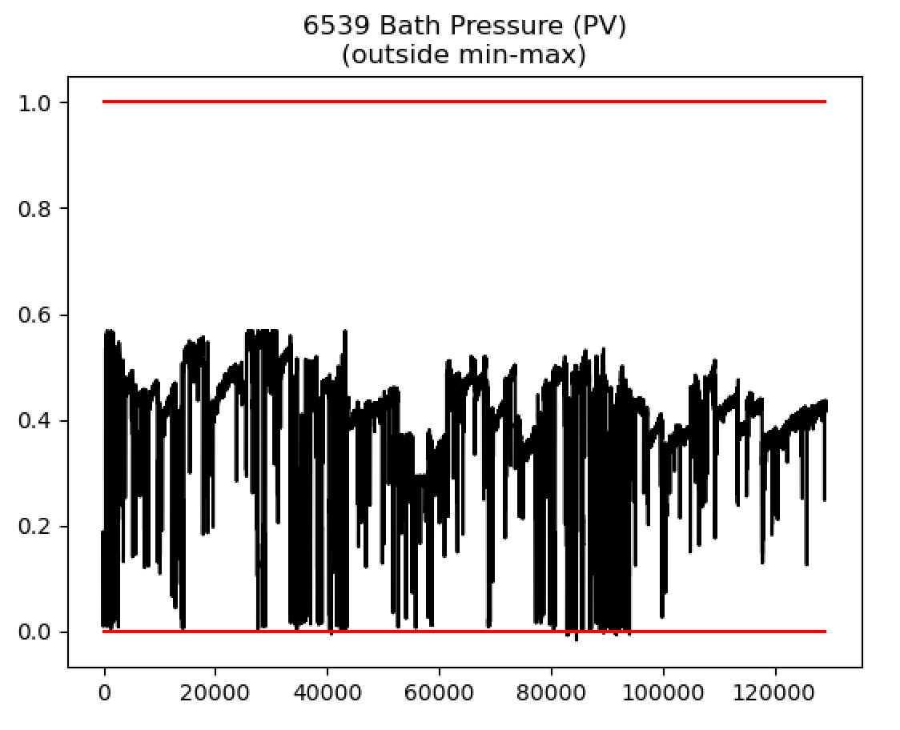
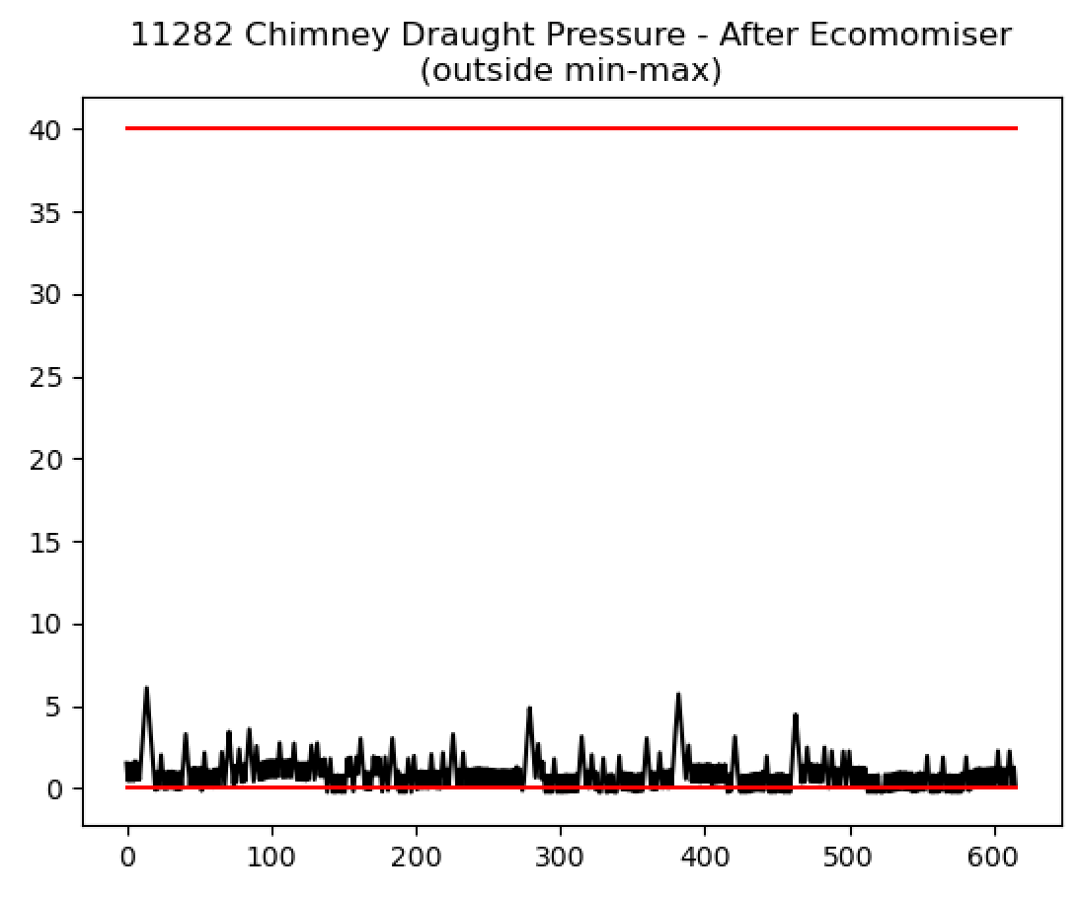
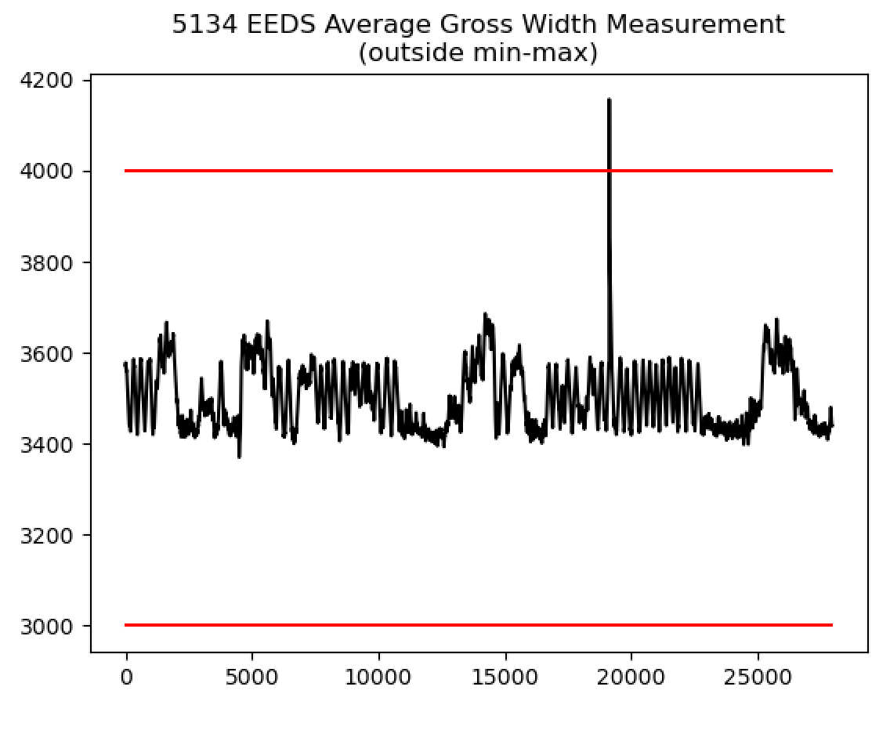
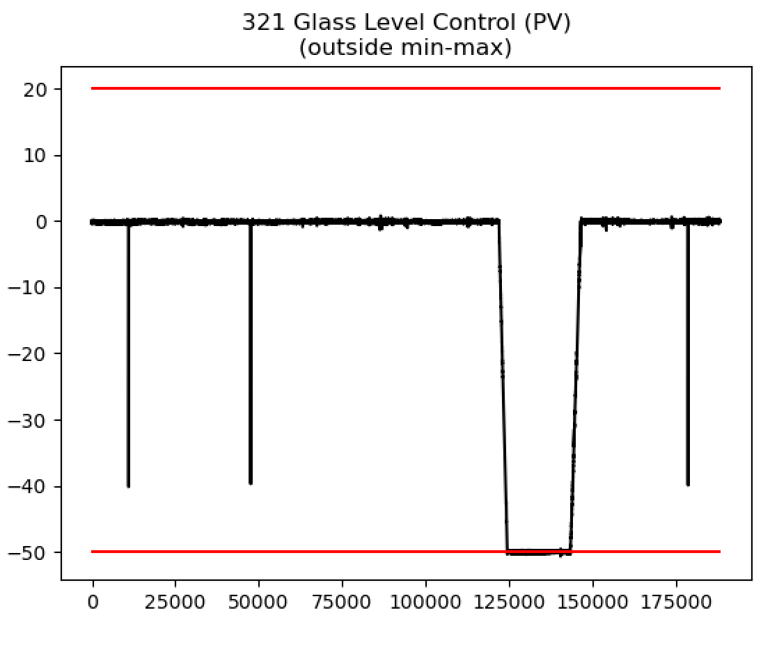
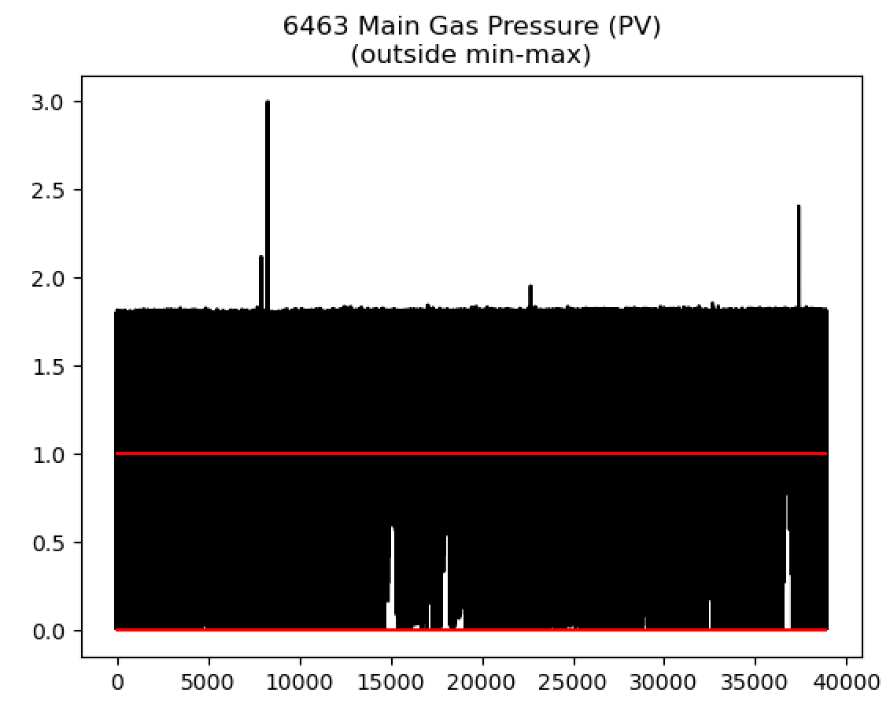
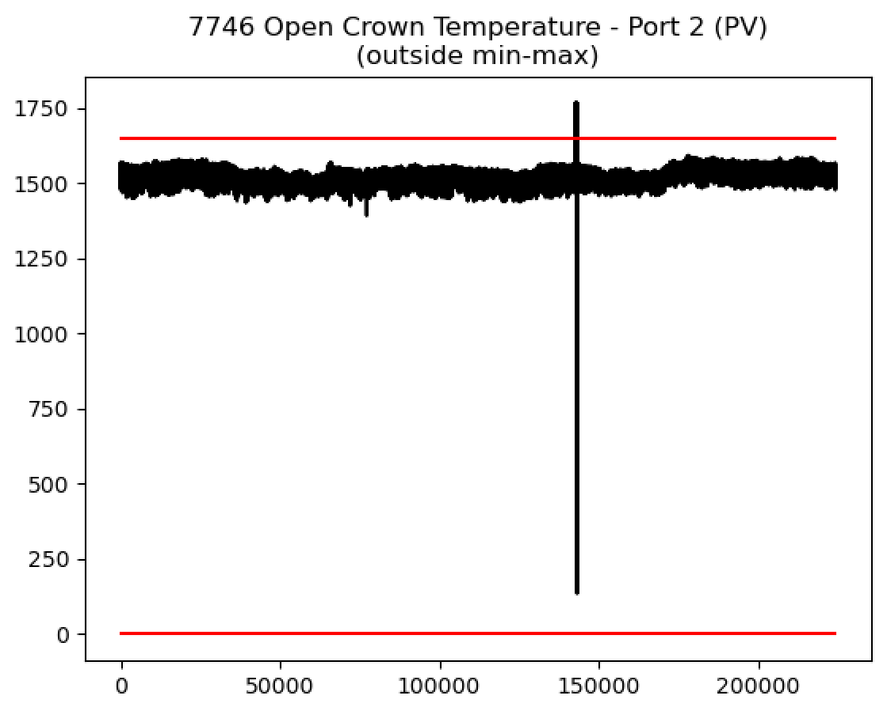
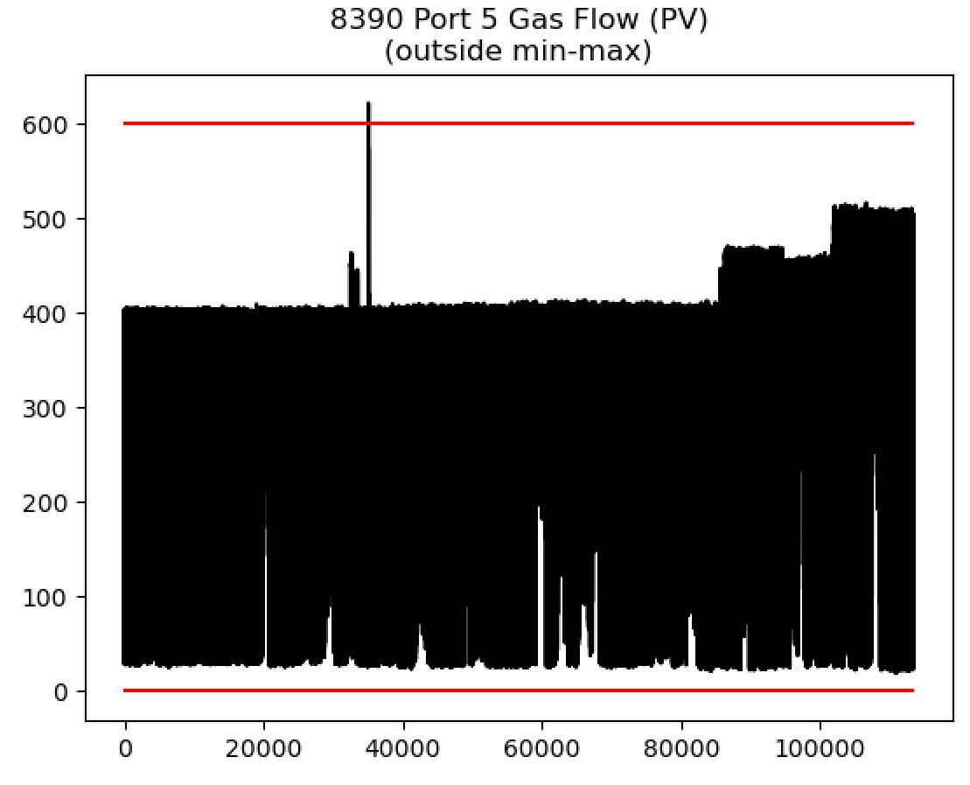
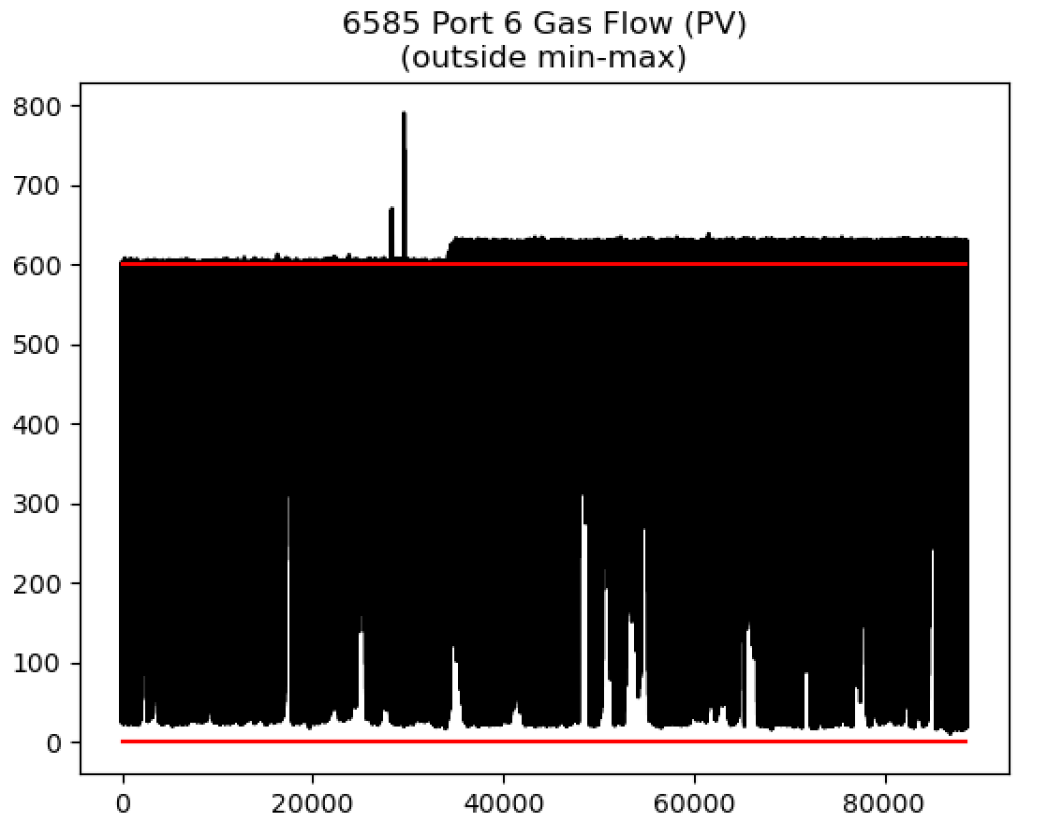
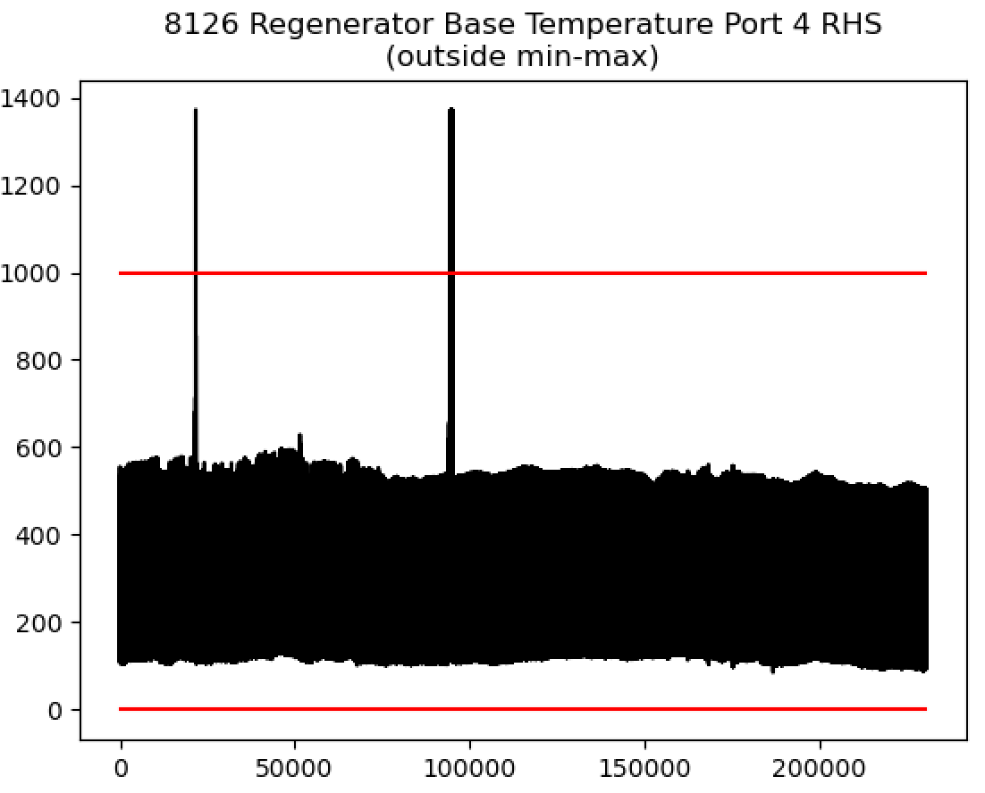
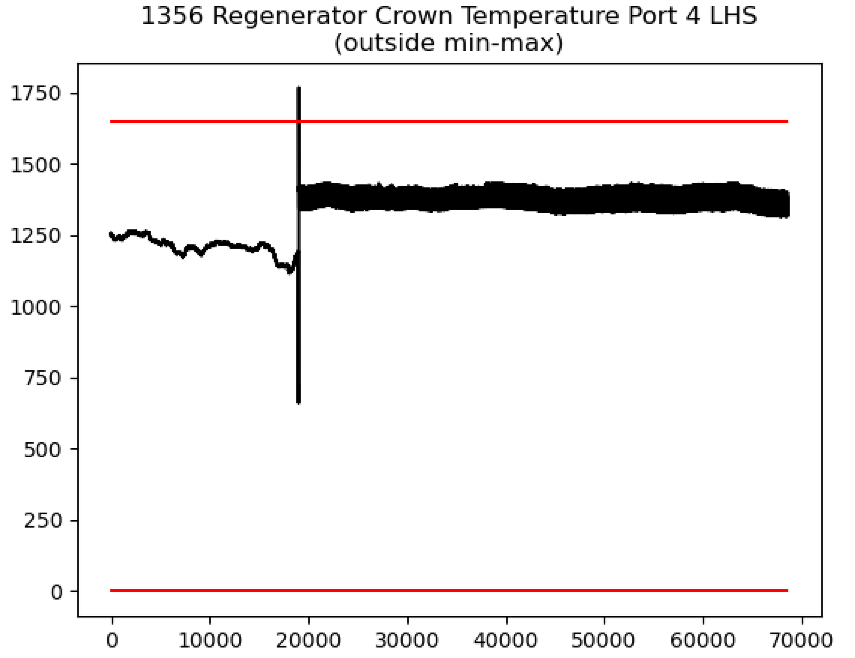
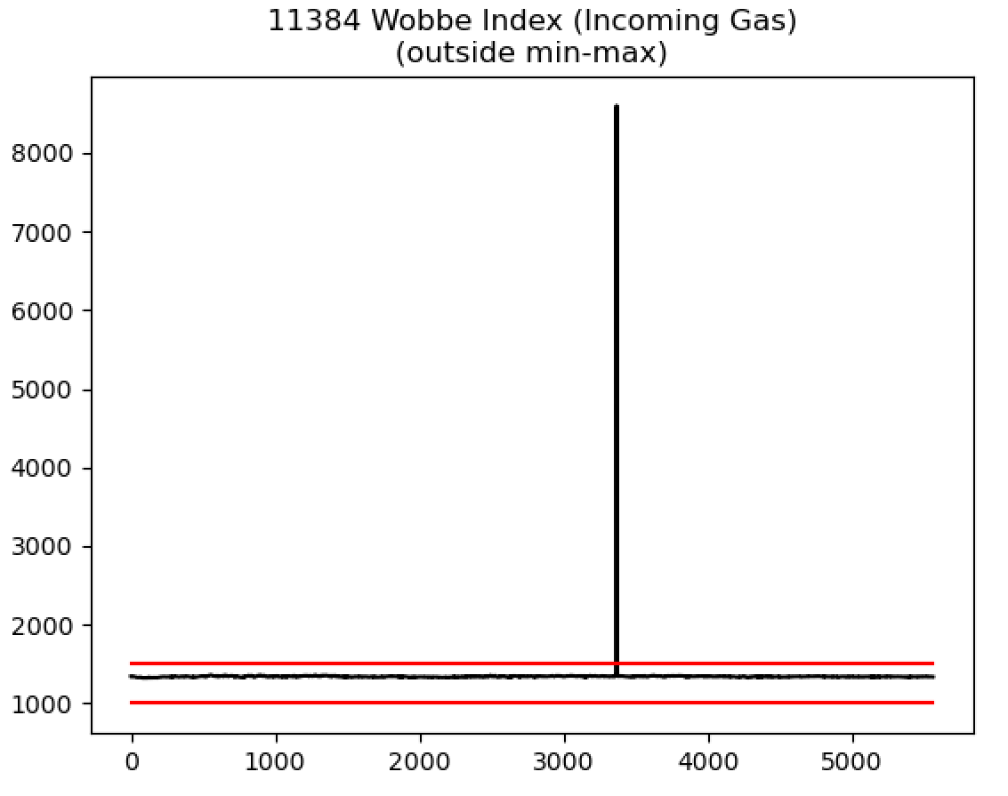

Slide 18
Min-Max error
For this type of signal we will need to be able to address the issue online.
This highlights a key development that we will need to make – moving the data processing pipeline online.
One obvious strategy would be to simply keep the signal equal to its previous value if it moves outside of this range.

Slide 19
Min-Max error
We will have to clearly highlight to the user that the model is doing this.
This could help to indicate when sensors are giving strange readings.

Slide 20
Min-Max error
Finally – clearly we need to tune the limits on this signal (or should it be removed?)

Slide 21
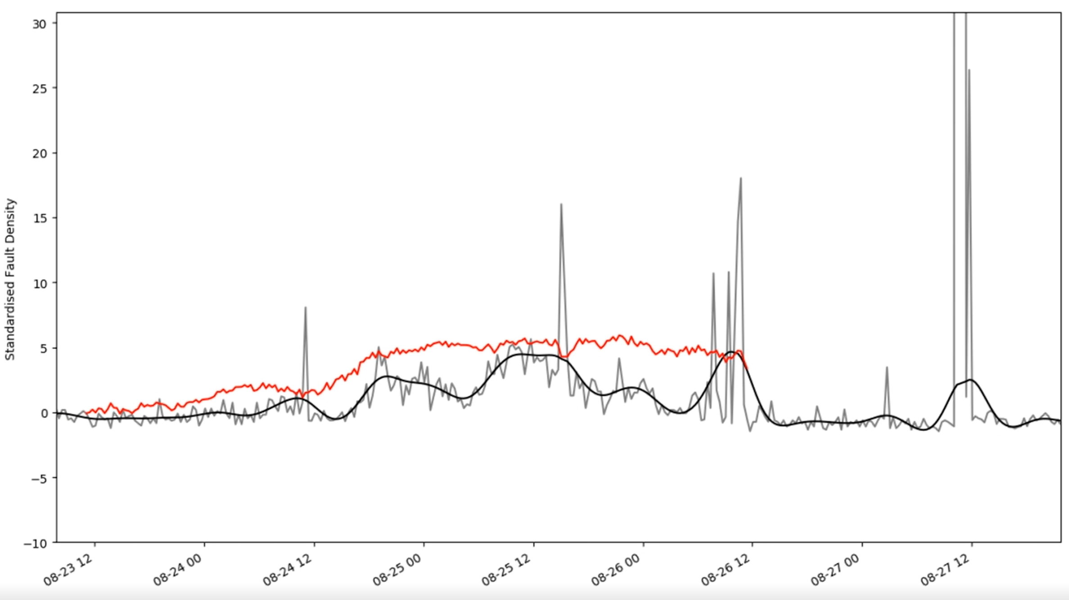
Expanding on last week’s online predictions
(Month-Day-Hour)

Slide 22
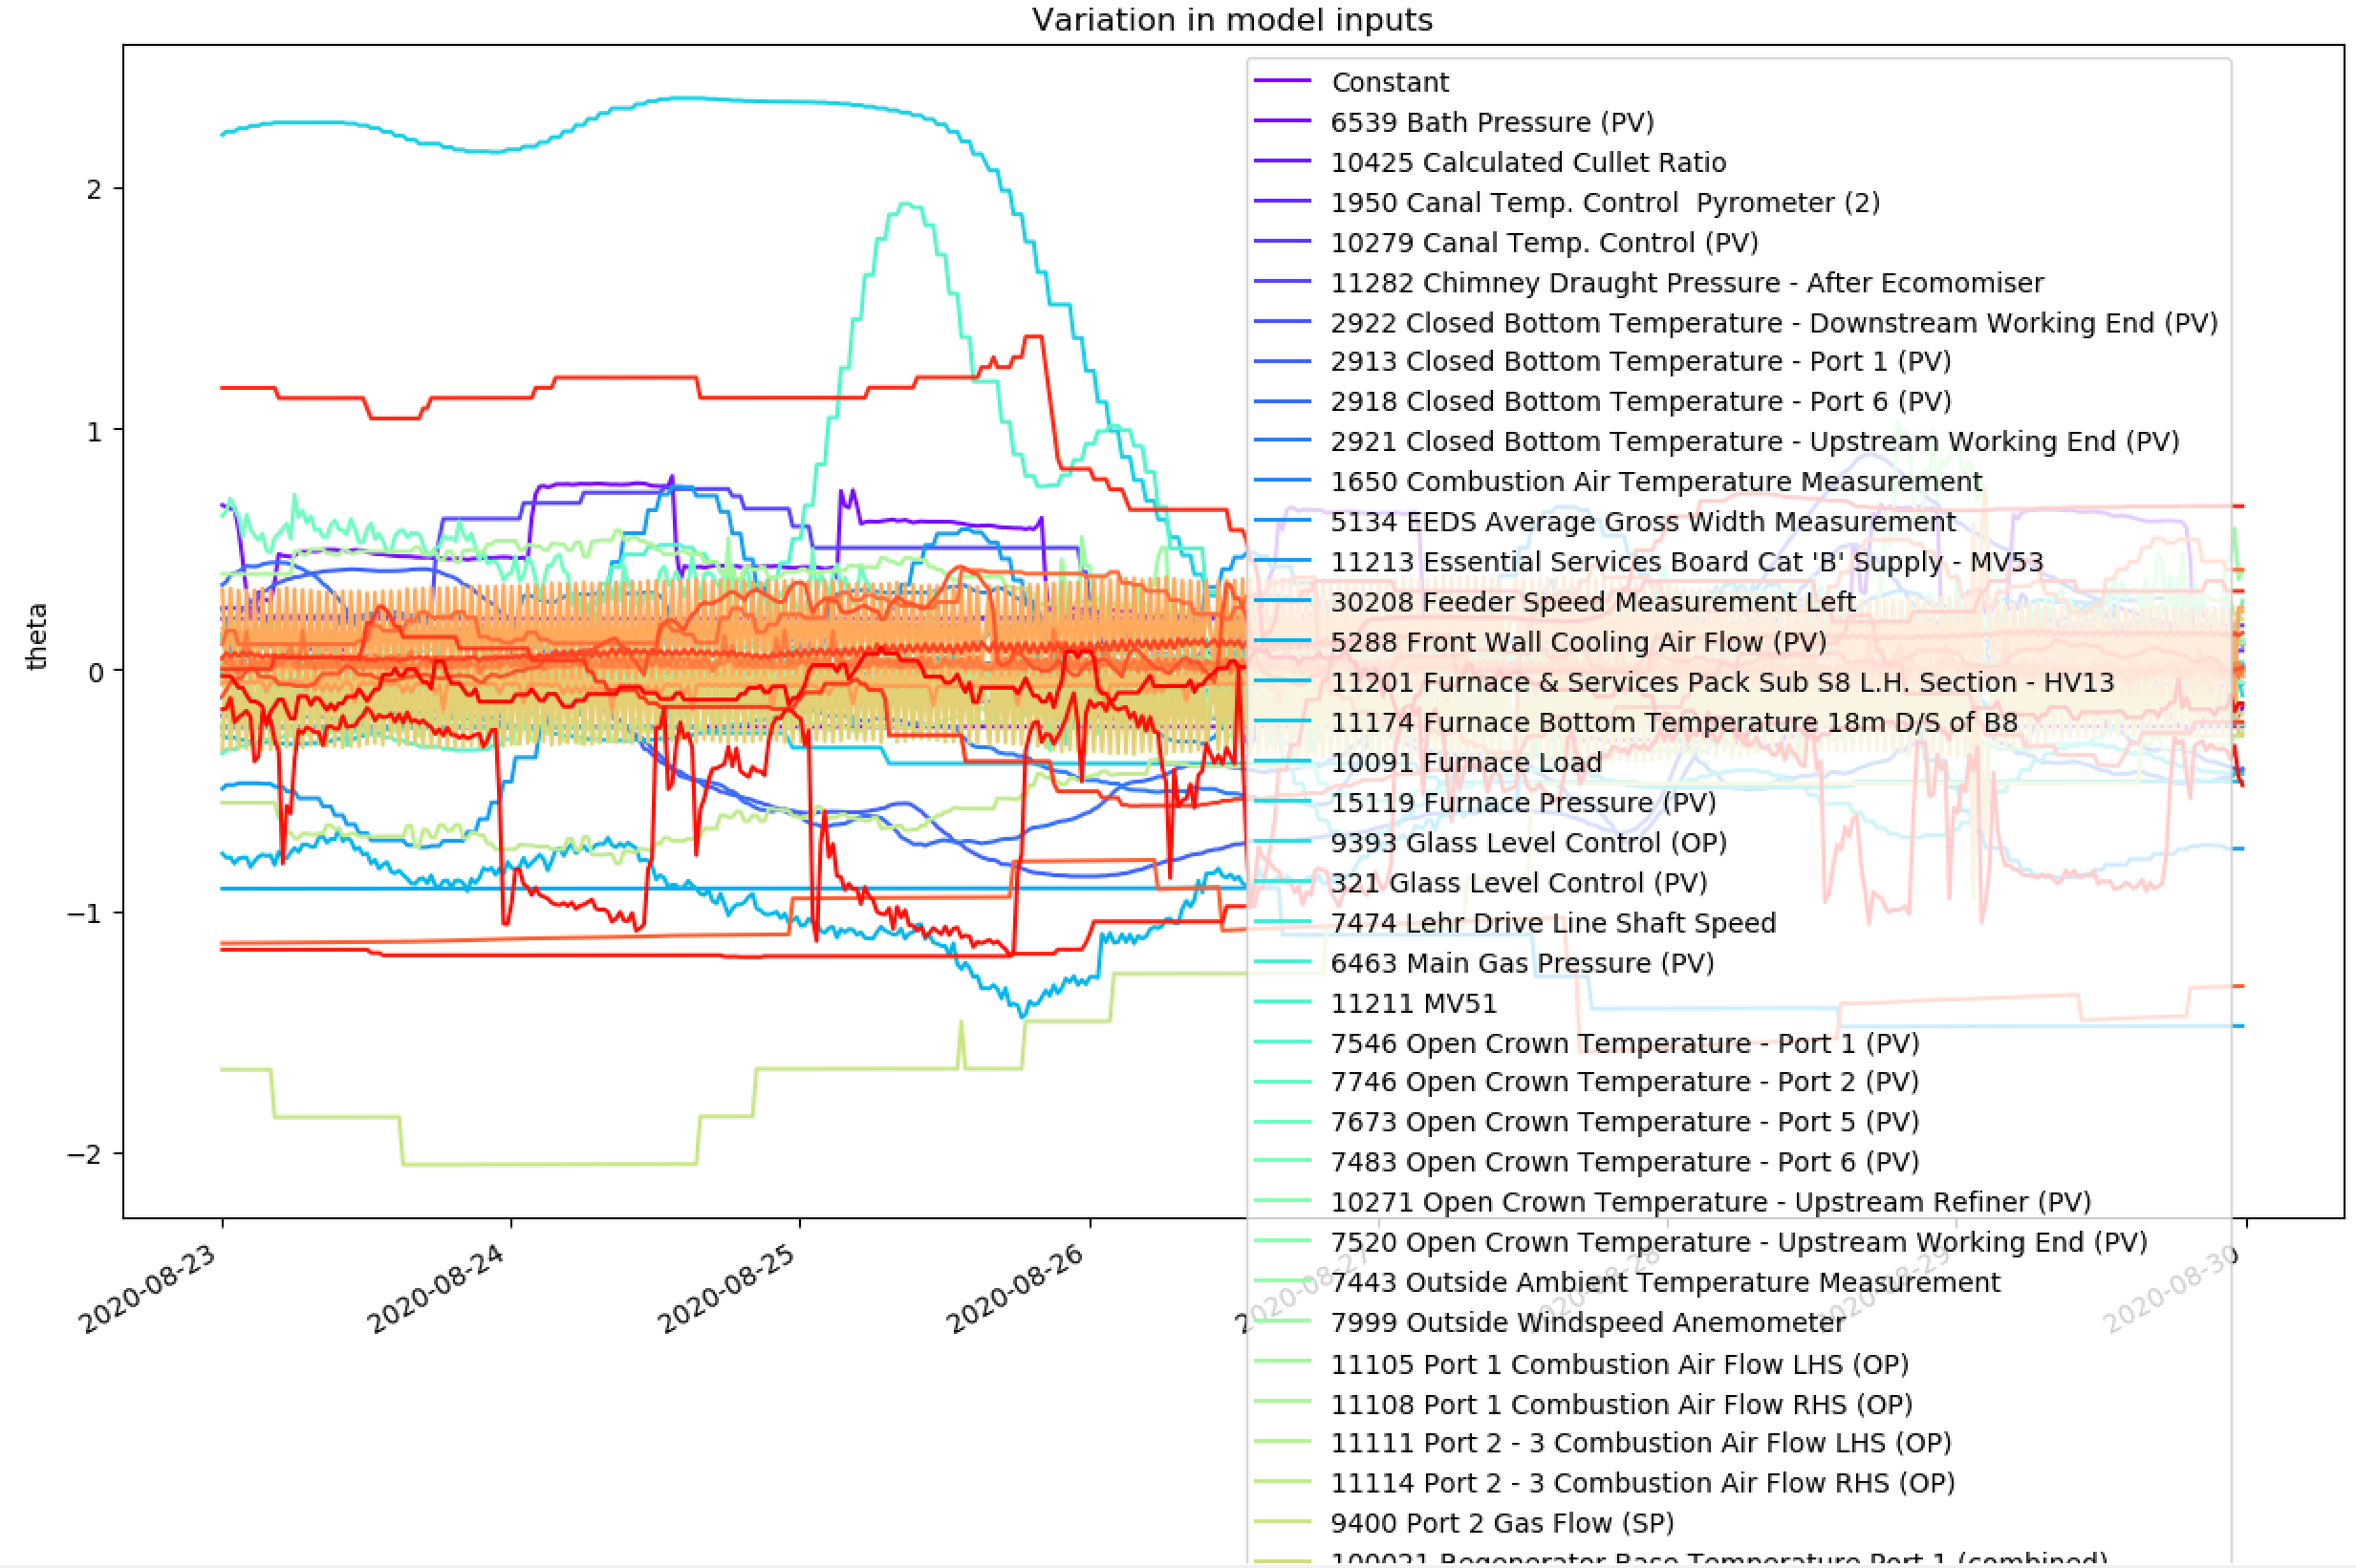
Expanding on last week’s online predictions
Obviously a very complex picture – can restrict the image to signals whose absolute value was larger than a constant over this date range.

Slide 23
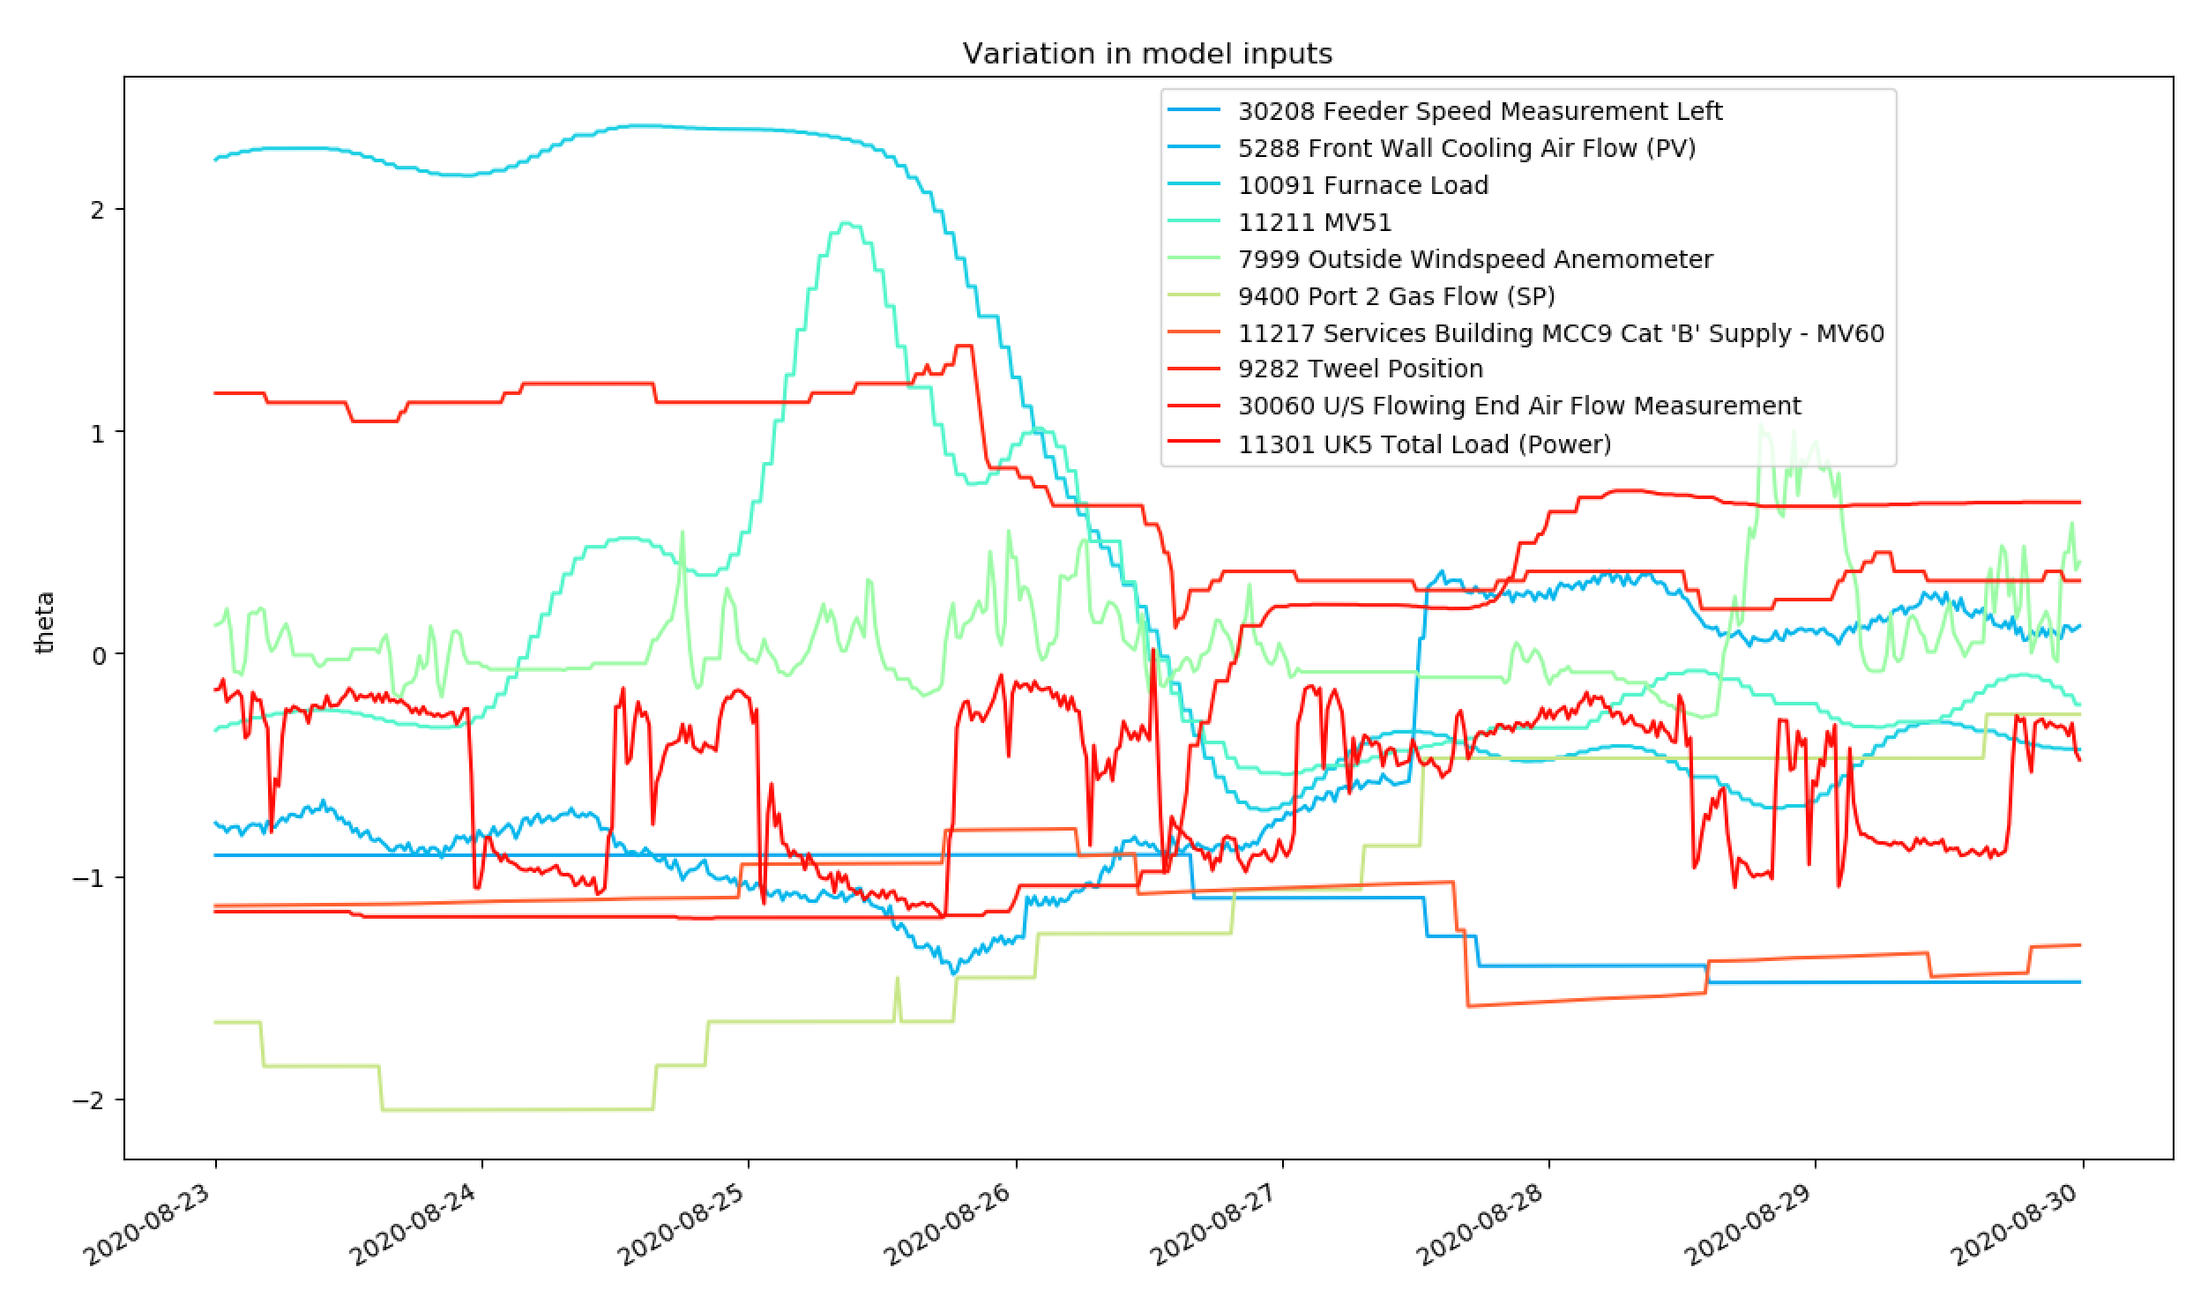
Expanding on last week’s online predictions
Setting the limit equal to 1…
Results are also saved to a spreadsheet but this code requires verification before sharing this.

Slide 24
Three Key Steps
Online strategy for addressing spikes in Furnace Faults
We are working on an approach together but there’s also the potential for the model to learn a definition of outlier.
This may require 1 or 2 weeks depending on how well the tasks can be divided between us; depends whether or not we think we’ll need it.
Realising future predictions with unknown furnace properties
We have proposed an approach (linear dynamical system)
This is fairly involved and might need up to 2 weeks
Online strategy for the data-processing pipeline
For now this just involves dealing with inputs outside of their engineering range
We will have to start learning about how Sequoia will deliver the online data

Slide 25
Thank you for your attention. ANY QUESTIONS?

